Slide 1
Budgetary Affairs Committee
October 18, 2018
Referrals/issues status:
Capital plan: classroom expansion = this report
24/7 Library costs = this report
Voluntary Separation program = this report
Renovation of CSF for Marketing and Communications
PhD tuition waivers = ongoing
Distribution of raises given to administrators, faculty, and staff = still awaiting data from F&O
Continuing:
Report on the “big picture balance sheet”, with tracking of changes in each item
Current and next FY budget = this report

Slide 2
Classroom expansion
Had been planned in Schenk expansion, more immediate need (leaves Schrenk expansion est. at $44.6 million)
Build onto Computer Science Bldg
300-seat auditorium
Four 100-seat classrooms
$7.6M cost estimate
Source of $
$2M from “inactive quasi-loan fund”
$1M from maintenance and repair (= maintenance and repair on Comp Sci bldg.)
$1M fundraising
$1M from last year’s enrollment contingency fund
$0.8M from Deans
Remainder ($1.8M) from unrestricted reserves (= leftover funds in accounts)

Slide 3
24/7 Library
$29,357 on card swipe access and cameras
~$50K annual operating (two CSOs, $9.50/hr or less)
Card swipe outside normal hours
24/7 during regular semesters, not intersession nor holidays
Centennial now locks at 8 pm

Slide 4
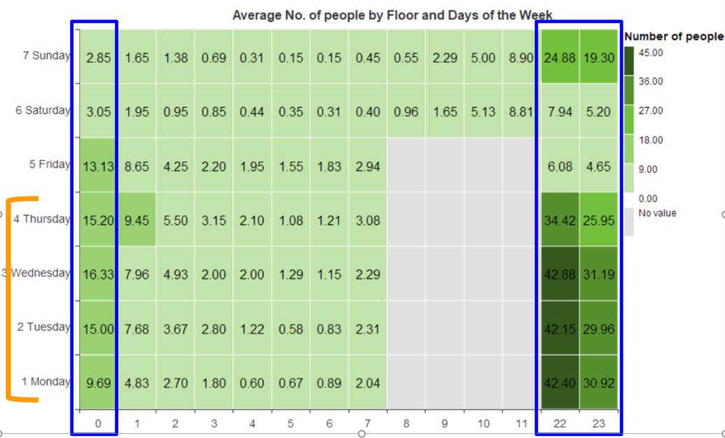
Usage: averages, Sep 11 – Oct 17

Slide 5
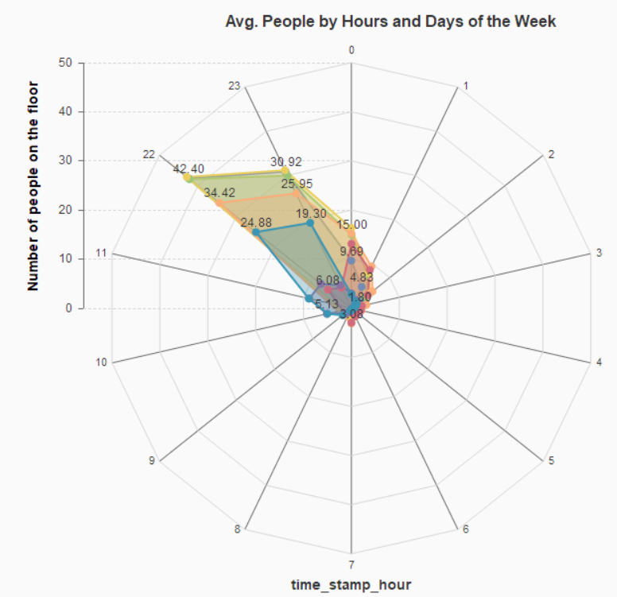
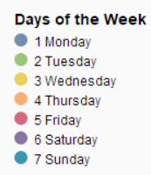
Very few people stayed after midnight

Slide 6
Voluntary Separation Program
Based on draft of program:
Eligible = Tenured, vested, age ≥ 62 years on 1 August 2019
Incentive = 1.5 x benefits basis salary (not clear if summer included), maximum $200k
Severance on 31 August 2019 (retired on 1 Sept 2019)
Packets provided in February, enrollment by 25 March 2019
Retired are eligible to work up to 70% FTE
Funding = open lines, 1.3 years salary, positions likely remain open two years to fund buyout and accumulate startup

Slide 7
Campus Support Facility
Less than $300k, source = administrative savings
Gave Marketing and Communications one office, newish employees had been scattered
Space empty, had been phonathon, furniture gone or insufficient
Two-thirds of cost was furniture and equipment, movable
Demolition of CSF not in next 5 years

Slide 8
Expenditures and revenues (millions of $)
Values unchanged from June report
 | Revenue |  |  |  | Costs |  | Net
 | State | Tuition & Fees | Other | Net | GRA | Transfers to GRA | [Cost dollars?]
Two years ago (FY 17) | 51.4 | 81.2 | 12.5 | 145.1 | 146.3 | (5.8) | 4.5
Last year (FY 18) | 49.4 | 85.1 | 10.2 | 144.7 | 147.3 | (2.8) | 0.2
This year (FY 19) | 49.4 | 86.5* | 10.2? | 146.1 | 141.0 | (5.8)? | 8.0?
State: Oops, federal deduction not calculated correctly
Cash flow issues possible
*1% tuition rate + enrollment increase budgeted
Tuition & Fees is net = scholarships from general operating funds deducted
New costs: $400k OSP (VCR&G, compliance hire); CEC $212k faculty line; $20k E&E for CDiversityO; $50K for sesquicentennial celebration

Slide 9
Anticipated Changes for FY 20 (Cuts)
-1.2% = State, -3.5% = -1.5 M (not collection error)
-0.36% = Tuition, -0.5 M
-1.4% = 2% merit raise pool, -2 M
-0.7% = 1% equity pool, -1 M
-0.18% = P&T and PTR, -0.25 M
= Insurance, utilities, licenses, mandatory maintenance =?M
Proposed initiatives
-0.15% = Waive admission fee, -0.3 M
-1.7% = “16 to finish” free course, -2.4 M estimated
-5.7% = Net ~$8 M less

